Slide 1
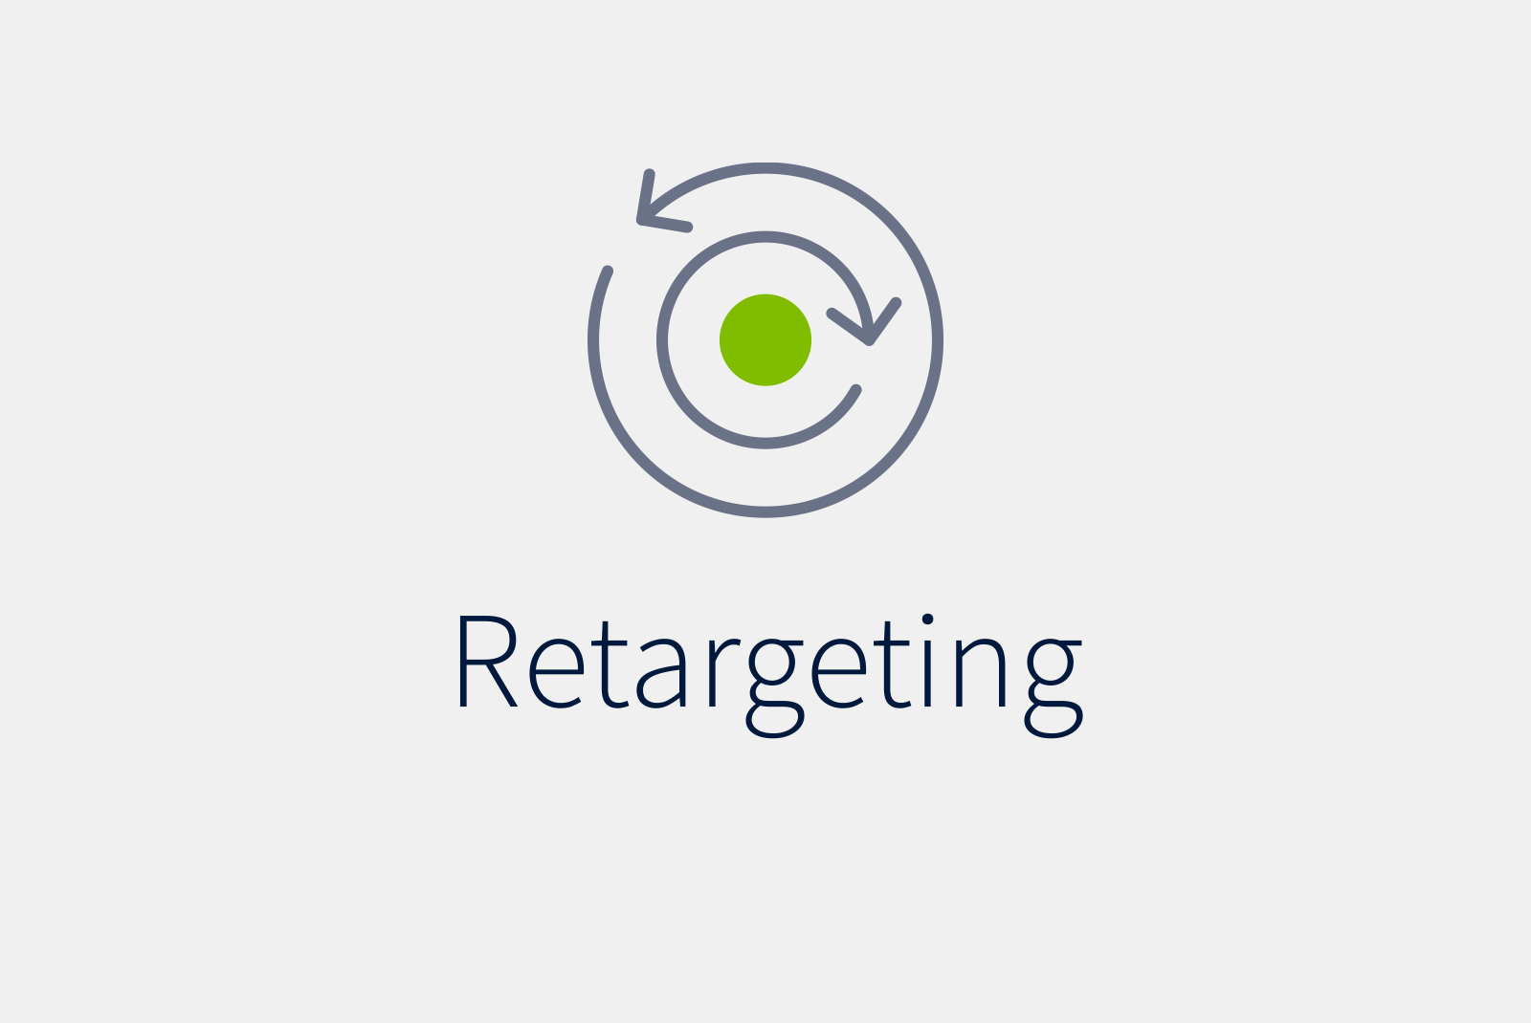
Automatic
Image

Slide 2
CONTENTS:
Introduction
Purpose of Study
Retargeting Process
What is a Seam?
Seam Carving – How it works
Energy calculation
Software & Hardware Requirements
Implementing System
Screenshots
Conclusion

Slide 3
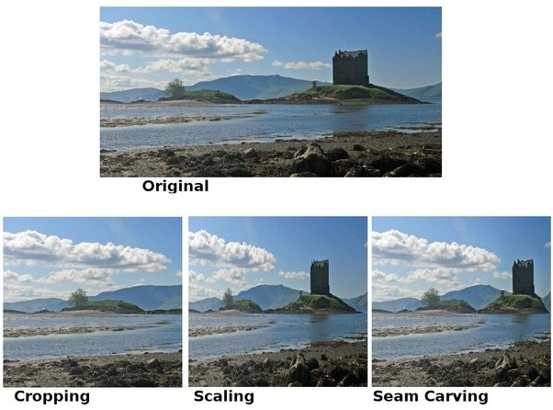
INTRODUCTION:
Modern technology delivers us different new display devices to suit our application needs. Common approaches include scaling and cropping, but the two methods create distortion and reduce important information to the contents and thus, deem undesirable.

Slide 4
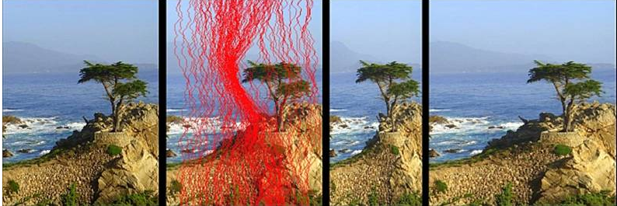
PURPOSE OF STUDY
When resizing images, you are normally faced with a choice: stretch, scale, or crop. But what if you could alter an image’s proportions in a way that respected its content altering the last noticeable parts of the image rather than cropping from the edges or stretching the whole thing? This is exactly the capacity provided by a technique called seam carving

Slide 5
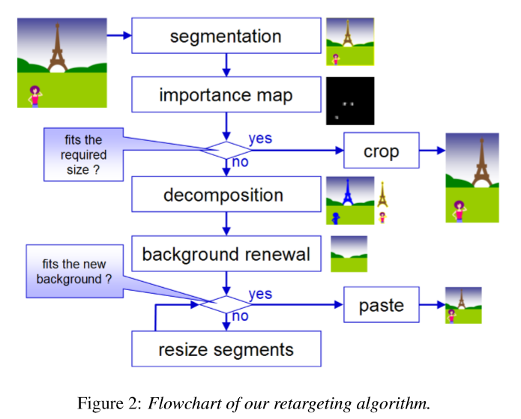
Retargeting Process

Slide 6
What is a Seam?
A seam is a connected path of low energy pixels crossing the image from top to bottom, or from left to right.
By successively removing or inserting seams we can reduce, as well as enlarge, the size of an image in both directions.

Slide 7
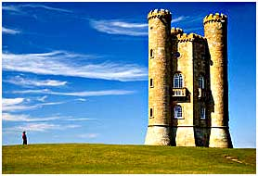
Seam Carving – How it works
1) Take an image such as
Original Image

Slide 8
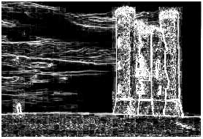
Seam Carving – How it works
2) Gradient magnitude
Image showing gradient magnitude

Slide 9
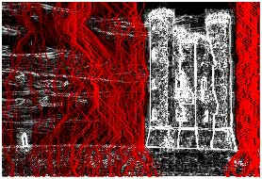
Seam Carving – How it works
3) Dynamic programming
Image showing seams with the energy function

Slide 10
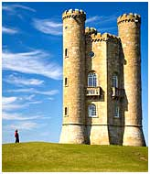
Seam Carving – How it works
4) Reduce the size of the image by removing the seams
Resized Image after removing seams

Slide 11
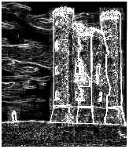
Seam Carving – How it works
Recalculated energy function of the image

Slide 12
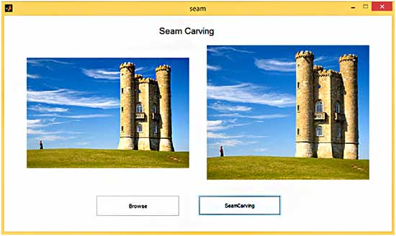
Seam Carving – How it works
GUI in MATLAB for seam carving

Slide 13
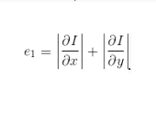
Energy calculation
The first step is to calculate the energy of a pixel, which is a measure of its importance—the higher the energy, the less likely that the pixel will be included as part of a seam .
Thus, we need to introduce an energy function that would map a pixel into energy value. For instance, we can use gradient of the pixel:

Slide 14

Software & Hardware Requirements
Software Requirements:
Hardware Requirements:
Processor: Intel Core™ i3-3217U CPU @ 1.80GHz
Installed Memory (RAM): 4.00 GB
System: 64-bit OS

Slide 15
Implementing System
We implemented the seam carving algorithm in MATLAB.
Then to make the .EXE file we used the deploy tool command.
Once we use that command a window pops up as shown in the screenshots taken, there we select the very first option i.e. the standalone program .
After that again a new window pops up where we add all the codes (.m files) into the portion where we add all the files required to run the application.
And then add the main .m file that will run as the user interface at the top and click on make package ,MATLAB then creates a folder with all the required things and the .EXE file.

Slide 16
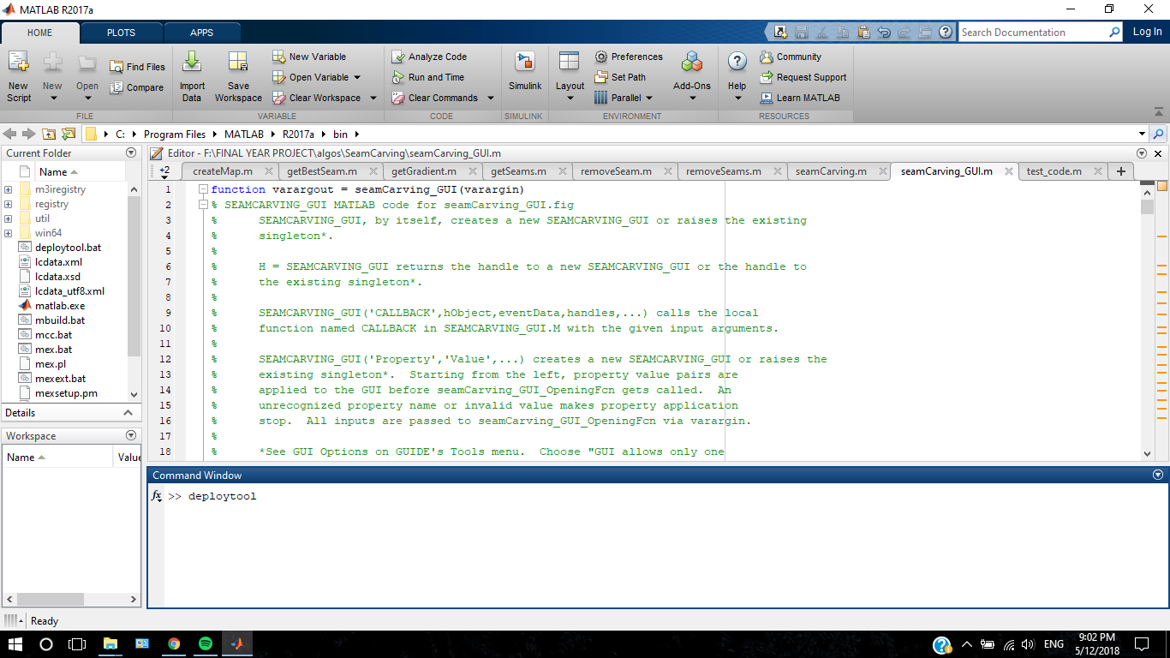
Implementing System

Slide 17
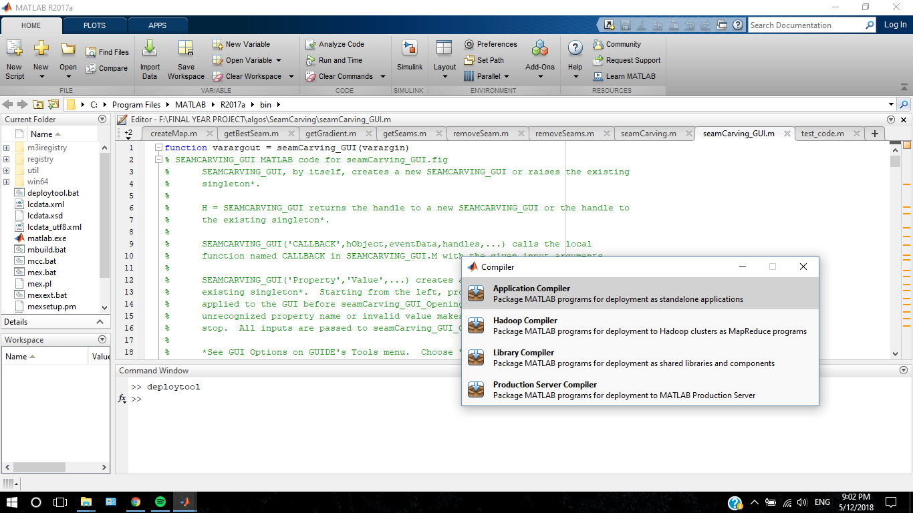
Implementing System

Slide 18
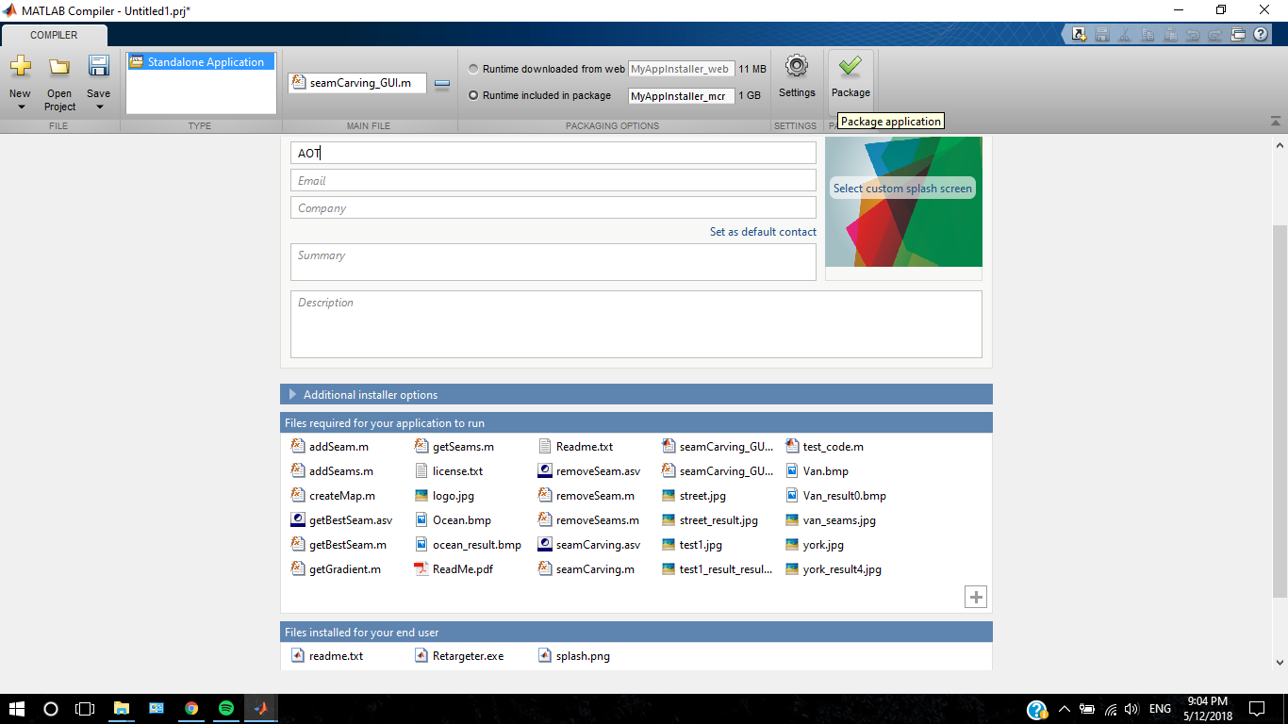
Implementing System

Slide 19
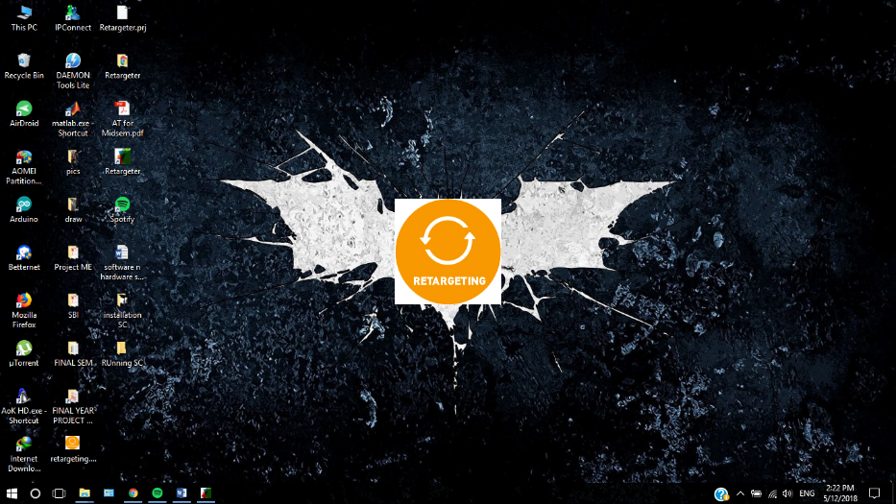
Screenshots
Running of .exe file→
1>Running .exe file

Slide 20
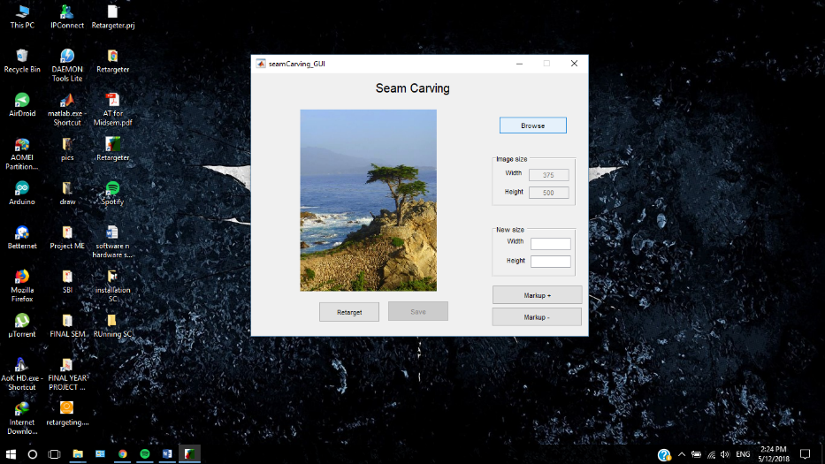
Screenshots
Running of .exe file→
2>Seam Carving_GUI

Slide 21
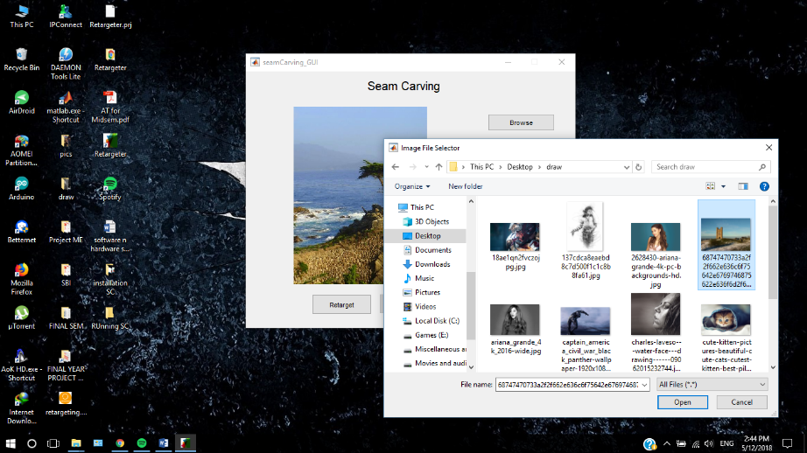
Screenshots
Running of .exe file→
3>Browsing the image to retarget

Slide 22
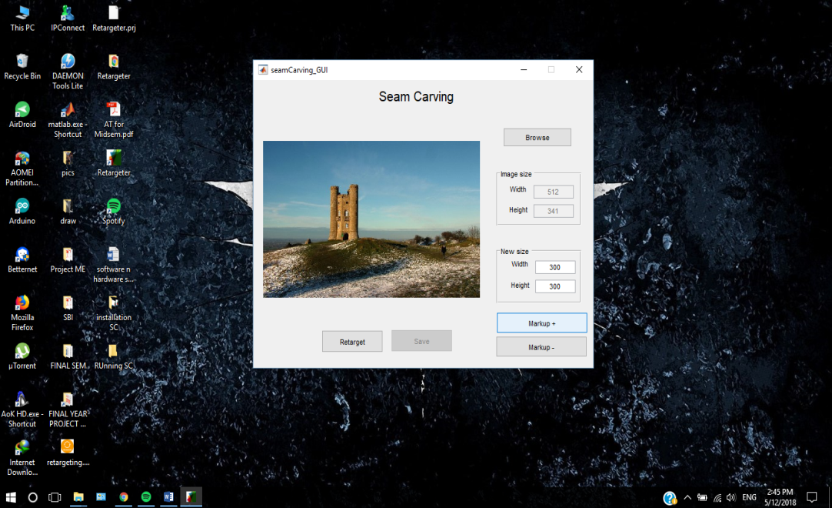
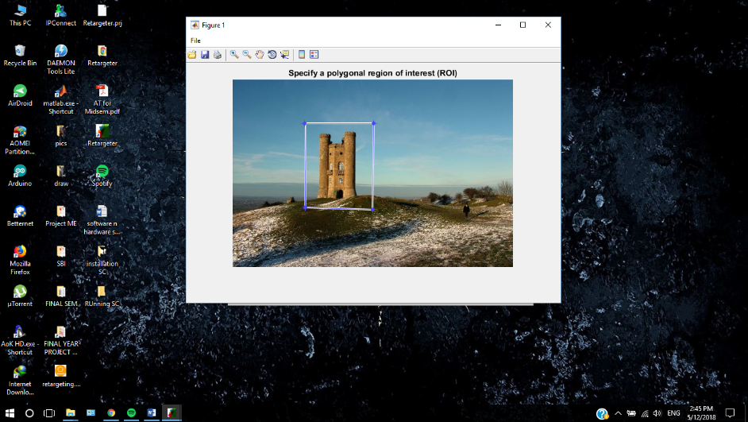
Screenshots
Running of .exe file→
4>Specify the ROI (Region Of Importance)

Slide 23
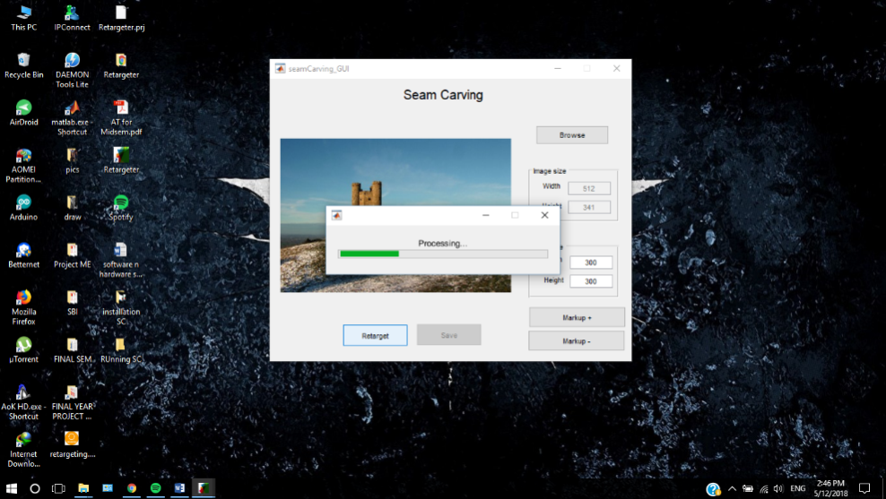
Screenshots
Running of .exe file→
5>Processing

Slide 24
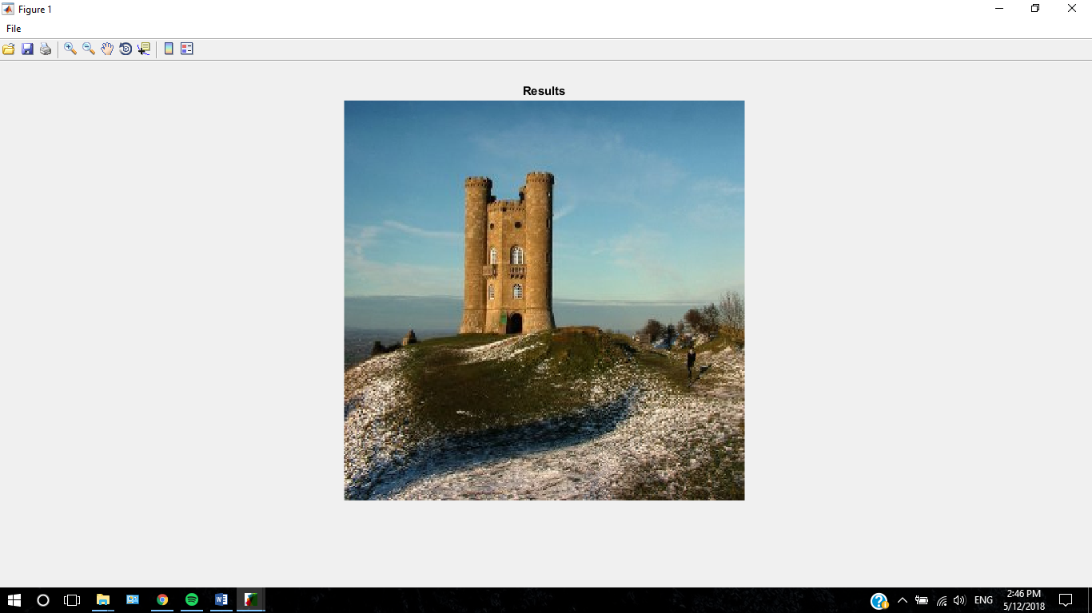
Screenshots
Running of .exe file→
6>Result

Slide 25
CONCLUSION
The processing time depends on the size of the image.
Complexity of the retargeting process directly proportional to the size of the image.
Using our implemented .exe file we can select the region of importance(ROI) of the image.
After retargeting we can save the retargeted image.

